Slide 1
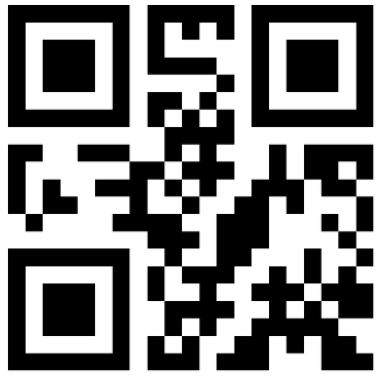
Please register your attendance by scanning the QR code below
GEOG0186/GEOG0188
Registration needs to be logged
by 09:20am
Code: 613466
Room 422/423 Malet Street (Birkbeck)
Group A: 09:00 to 10:00am

Slide 2
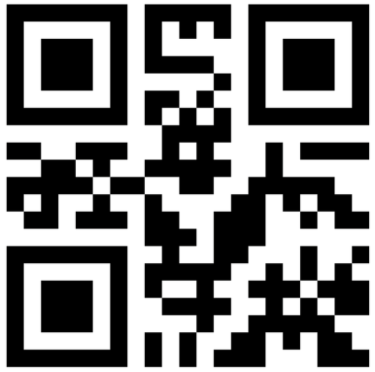
Please register your attendance by scanning the QR code below
GEOG0186/GEOG0188
Registration needs to be logged
by 10:20am
Code: 787702
Room 422/423 Malet Street (Birkbeck)
Group B: 10:00 to 11:00am

Slide 3
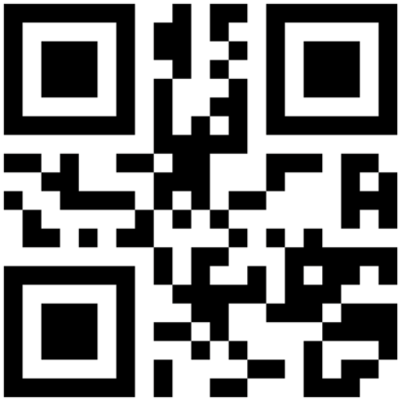
Please register your attendance by scanning the QR code below
GEOG0186/GEOG0188
Registration needs to be logged
by 11:20am
Code: 915810
Room 422/423 Malet Street (Birkbeck)
Group C: 11:00am to 12:00pm

Slide 4
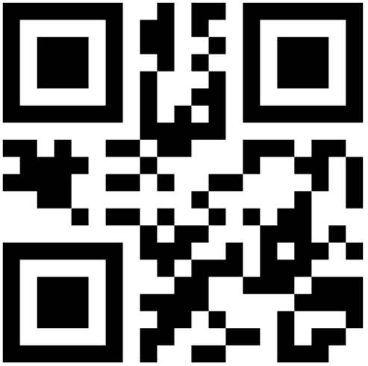
Please register your attendance by scanning the QR code below
GEOG0188
Registration needs to be logged
by 11:20am
Code: 407540
2.23 Chadwick Building (UCL)
Group D: 11:00am to 12:00pm

Slide 5
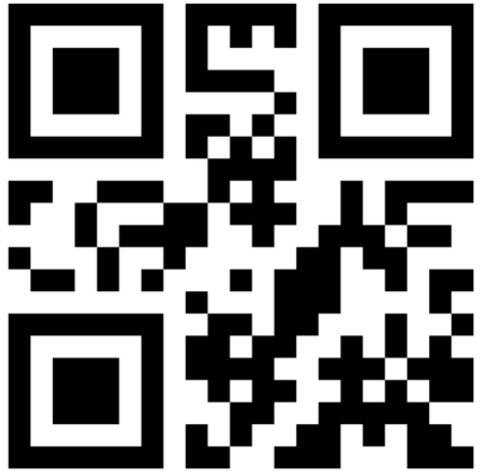
Please register your attendance by scanning the QR code below
GEOG0188
Registration needs to be logged
by 01:20pm
Code: 519974
G20 Christopher Ingold Building (UCL)
Group E: 01:00pm to 02:00pm

